Slide 1
2023 World Elder Abuse Awareness Day WEAAD
June 15th
Presented by: Peggy Jo
Native American Elder Justice Initiative National Resource Center (NAEJI)

Slide 2
World Elder Abuse Awareness Day (WEAAD)
World Elder Abuse Awareness Day (WEAAD) was launched by the International Network for the Prevention of Elder Abuse and the World Health Organization at the United Nations. The purpose of WEAAD is to provide an opportunity for communities around the world to promote a better understanding of the abuse and neglect of older persons by raising awareness of the cultural, social, economic, and demographic processes affecting elder abuse and neglect.
National Day of Awareness is every year on June 15th

Slide 4
Elder Abuse
Most elder abuse cases are undetected, under-reported, and unresolved resulting in injury, financial decimation, and even death.
World Elder Abuse Awareness Day (WEAAD) is an opportunity to recognize over one million Americans aged 65 or older who have suffered abuse. According to the National Center on Elder Abuse, it is estimated that for every one case of reported elder abuse, neglect, exploitation, or self-neglect, about five more incidents go unreported.

Slide 5
What is elder abuse?
Sexual abuse: Sexual contact that is forced, tricked, threatened, or coerced upon an Elder, including those who are unable to grant consent
Warning Signs: Bruises around the breasts or genital areas and unexplained sexually transmitted diseases
Abandonment: Desertion of an Elder person by an individual who has assumed responsibility for providing care for an Elder, or by a person with physical custody of an Elder
Warning Signs: Being left dirty or unbathed, unsuitable clothing or covering for the weather
Financial or Material Exploitation: Theft, fraud, misuse, or neglect of authority to gain control over an Elder's assets
Warning Signs: Sudden change in finances and accounts, altered wills and trusts, unusual bank withdrawals, checks written as loans or gifts, and loss of property

Slide 6
What is elder abuse?
Warning Signs: Broken eyeglasses or frames, unexplained signs of injury, such as bruises, welts, or scars, especially if they appear symmetrically on two sides of the body
Neglect: Refusal or failure to fulfill any part of a person's obligations or duties to an Elder
Warning Signs: Unusual weight loss, malnutrition, dehydration, untreated physical problems, such as bed sores
Self-Neglect: An adult's inability, due to physical or mental impairment or diminished capacity, to perform essential self-care
Warning Signs: Poor personal hygiene/not bathing or taking care of hair and nails, poor medication management or refusing to take medication, dehydration, malnutrition or other unattended health conditions
Physical abuse: Hitting, pushing, shaking, slapping, or use of physical force that may result in bodily injury, physical pain, or impairment to an Elder
Spiritual abuse: Causing harm to an Elder's spiritual well-being
Warning Signs: Not taking Elders to spiritual ceremonies or taking Elders' ceremonial items

Slide 7
Ways to participate:
Join
You can join us to make a difference and strengthen your community. Here are just a few ways you can participate:
Watch
Watch National Indigenous Elder Justice Initiative WEAAD videos titled Getting to Know a Native Elder, and A Discussion of Elder Abuse for World Elder Abuse Awareness Day
Host
Host a commemoration event and share your plans on the WEAAD event map
Use
Use #WEAAD in all of your WEAAD social media posts on Facebook and Twitter so that the nation and the world can see your commitment and planned activities
Show
Show your support by using this WEAAD Zoom background
Listen
Listen to a WEAAD podcast titled Lifting Up the Voices of Older Survivors: Sharing Strength & Resiliency Through Story
Learn
Learn more about WEAAD by playing WEAAD Bingo

Slide 8
National Indian Council on Aging Recommendations on Tribal Elder Abuse Codes
A tribal elder abuse code allows the tribe to establish tribal laws that protect elderly persons within the jurisdiction of the tribe from abuse, neglect, and exploitation. The codes provide identification and appropriate resolution of elder abuse, defining what agency receives and investigates suspected reports of abuse, and how elderly protection services are delivered.
When developing a tribal elder abuse code(s), it is essential that the code be created by each individual tribe rather than adopting a foreign code. Model codes are useful as examples, but tribes should embrace their sovereignty when creating their own. During development each tribe should incorporate their own tribal beliefs and values into the elder abuse code(s).

Slide 9
Section 1: Introduction to Tribal Elder Protection Teams
The Tribal Elder Protection Team (EPT) also commonly referred to as a Multidisciplinary Team (MDT) is a group of professionals, the elder, family members, and community members from diverse disciplines.
The team provides comprehensive assessment and consultation in addressing elder abuse concerns. The EPT provides assistance to their clients to promote coordination among service programs available to elders. Improve lines of communication to efficiently address elder abuse, neglect, and exploitation.
The EPT will increase relationships between tribal public service agencies while maintaining client confidentiality. Various professional disciplines are represented on the EPT. Membership is limited and is not open to all service providers, or members of the public. The Tribal Elder Protection Team Toolkit will define the roles and responsibilities of the EPT members.

Slide 10
Section 1: Introduction to Tribal Elder Protection Teams
Section 2: Developing a Tribal Elder Protection Team
Section 3: Developing Tribal Elder Abuse Codes
Section 4: Tribal Elder Protection Team Members
Section 5: Cultural Sensitivity Resources

Slide 11
Get Involved:
For more ideas and resources to help you get involved:
Visit the WEAAD website
The WEAAD outreach guide will help you plan and implement a successful World Elder Abuse Awareness Day event
Tips on how to take action in your community
Find other useful tools to spark community engagement and mindfulness

Slide 12
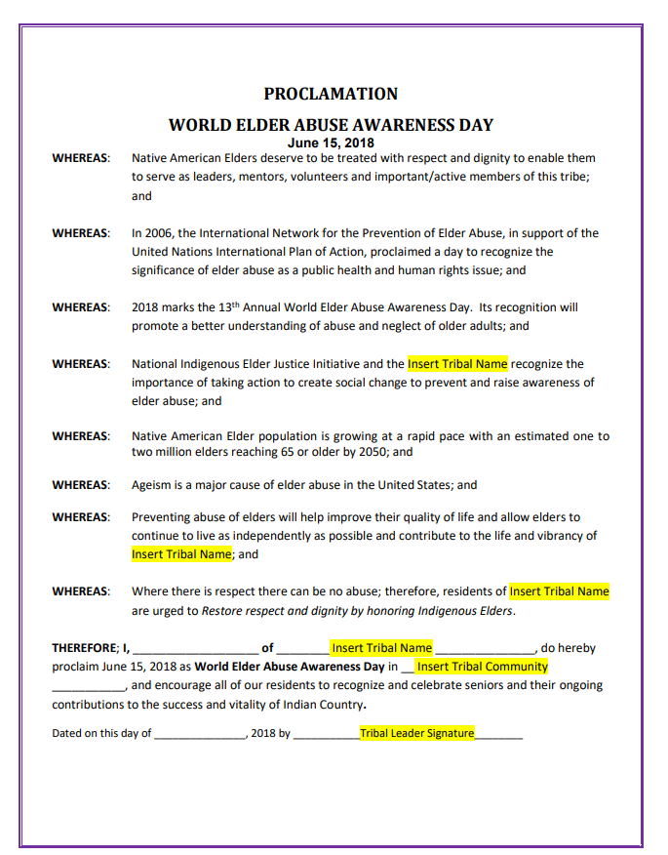
WEAAD Proclamation
This sample proclamation can be used by tribes to officially proclaim June 15 as World Elder Abuse Awareness Day within their tribal community.

Slide 13
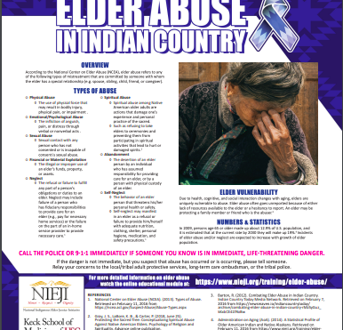

Slide 14
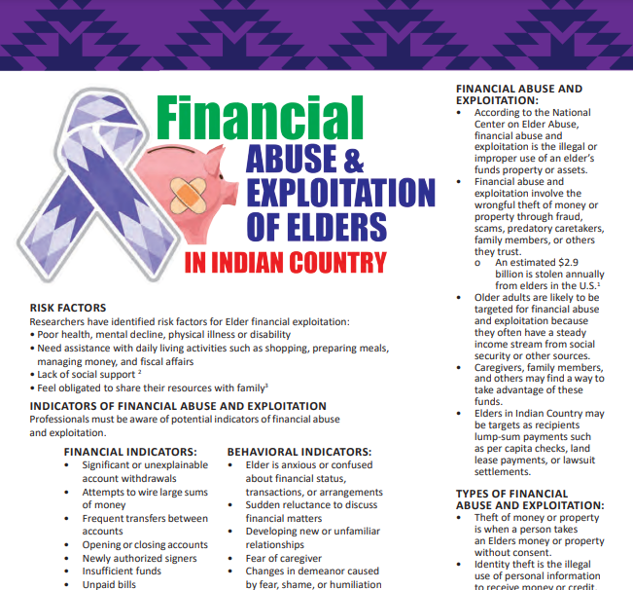
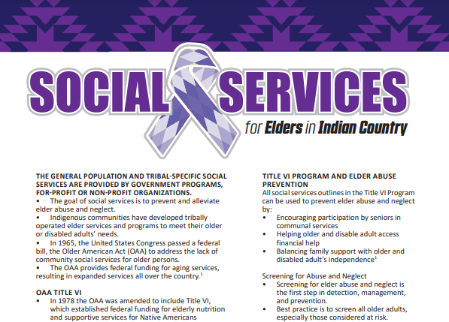
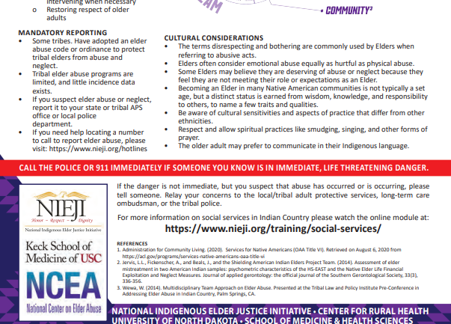

Slide 15
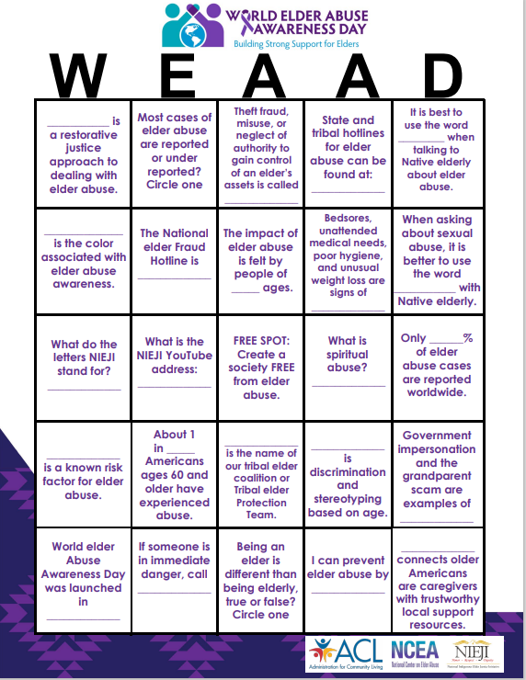
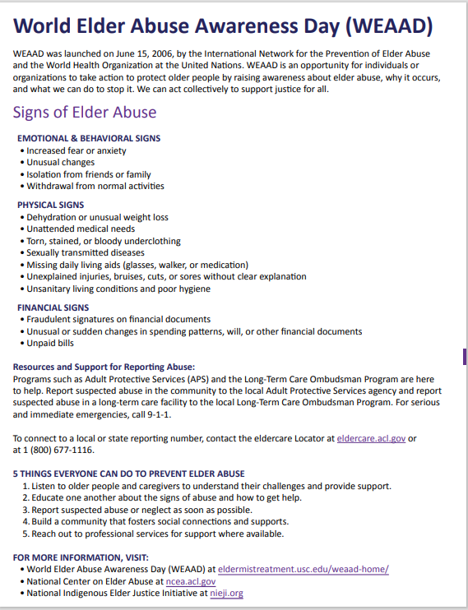

Slide 16
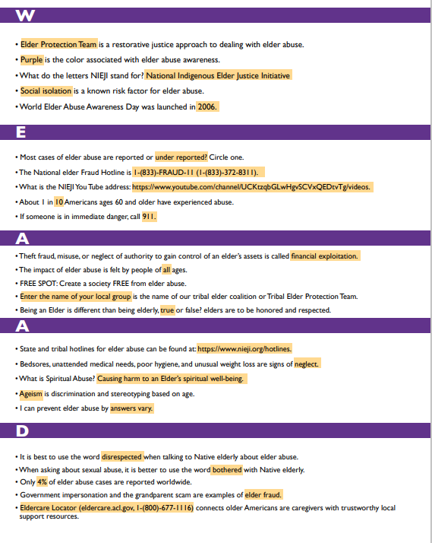

Slide 17
Getting to know a Native Elder
In recognition of World Elder Abuse Awareness Day (WEAAD) on June 15, the Native American Elder Justice Initiative is honored to share discussions with an Elder. This year's discussion is with John Eagle Shield an Elder from Standing Rock Sioux Tribe.

Slide 18
Getting to know a Native Elder

Slide 19
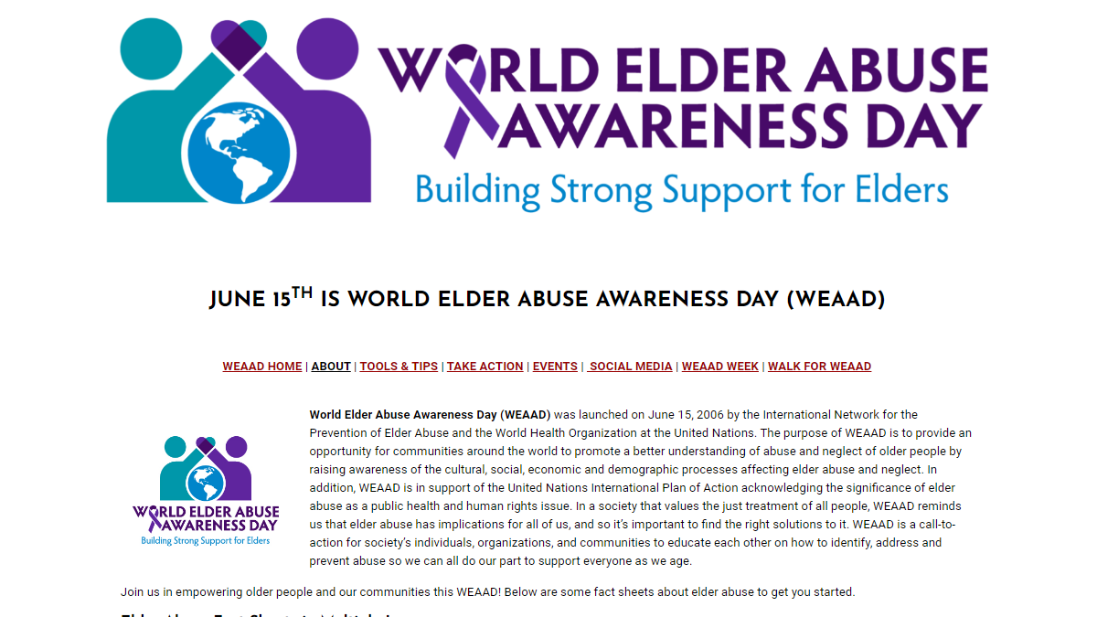

Slide 20
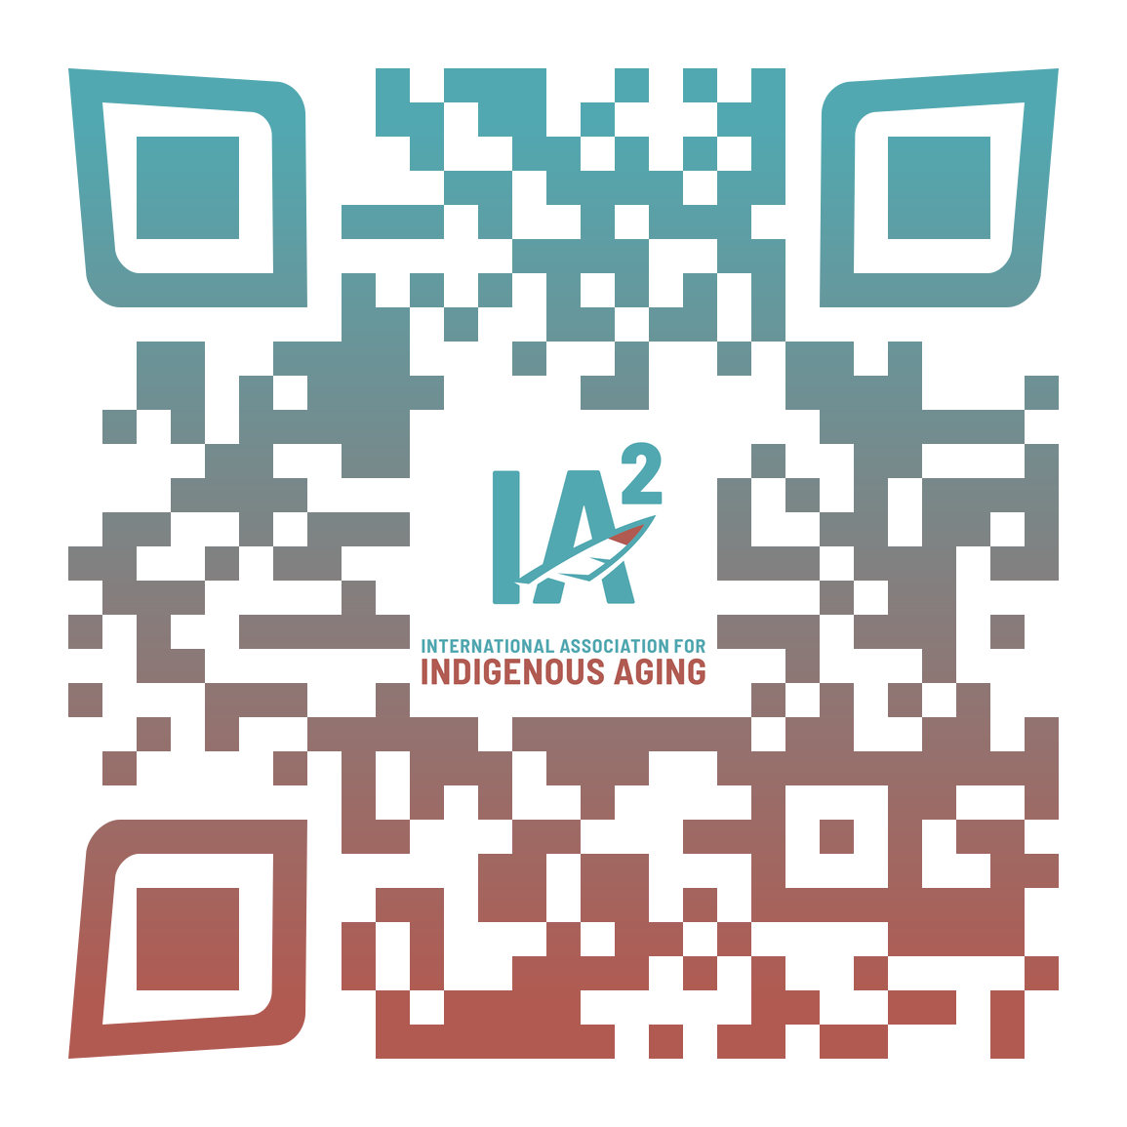
THANK YOU FOR ATTENDING
Download practical resources to support aging initiatives
Learn about cutting-edge efforts to improve aging care for American Indian & Native American communities
Subscribe to IA² e-mail, blog and social media
updates to learn about new programs and resources
International Association for Indigenous Aging
admin@iasquared.org
55
Notes:
Visit Iasquared.org to learn more

