Slide 1
The Savvy Caregiver in Indian Country
Savvy Caregiver Program American Indian / Alaska Native Trainer Essentials
This project is supported by the Centers for Disease Control and Prevention (CDC) of the U.S. Department of Health and Human Services (HHS) as part of a financial assistance award totaling $348,711 with 100 percent funded by CDC/HHS. The contents are those of the author(s) and do not necessarily represent the official views of, nor an endorsement, by CDC/HHS, or the U.S. Government.

Slide 2
The Savvy Caregiver Workshop: Objectives
Help caregivers appreciate the scope and impact of their work
Reduce the potential adverse impacts of caregiving
Increase caregiver’s skills and knowledge for caregiving
Help caregivers adopt a more strategic outlook on their work
Help caregivers develop more effective strategies for caregiving and decision making
Improve caregivers’ self-care skills
Improve the quality of life of care recipients
Increase involvement of families and other resources
Notes:
This is a brief overview of what we hope to accomplish today. We’ve built in a few 2-person breakout sessions throughout to help break up the discussion and tap into the folks in the group who bring their own level of experience and expertise that we can all learn from. Given the size of the group we won’t have time to have everyone reflect from every discussion, but I am hoping that we can have one person from each group provide a summary of the discussion in the chat box. I’ve also set up some poll questions for each of the breakout questions. I’m not sure which feature will be easier or most accessible for folks, but wanted to provide a couple options for responding and ensuring that you have the opportunity to share and reflect and make your voices heard.
I do want to acknowledge that even though I’m a nurse I don’t have a clinical background in Alzheimer’s disease or dementia. The focus today isn’t an in-depth or clinical overview of the disease processes, rather helping point out available resources, tools, and information you might find useful in your work.
I will share a brief background on our organization, a few slides on dementia and Alzheimer’s and an overview of current and future plans for our project activities as well as highlight other tools, resources and funding opportunities you will hopefully find of use in your work.
I’m hopeful we will have time for all three 2-person breakout sessions. If we run short, we may have to cut out the last session, in which case we still have the poll questions set up. We are really interested in getting feedback on your needs for information resources to use in your work and with your community. If we don’t get to the final group, please do be sure to answer the final set of poll questions.
Feel free to stop and ask questions throughout. I’m, not great about managing the chat and powerpoint at the same time, so bear with me! I hope to make this an engaging workshop type experience for folks today.

Slide 3
How the Savvy Caregiver Workshop Works
Group Sessions:
- Exercises
- Talks
Caregiver Home Activities:
- Reading
- CD-ROM
-Exercises
- Assignments
Group Sessions:
- Exercises
- Talks
- Reports on Home Activities
- Feedback
Notes:
IA squared was found almost 20 years ago by Dave Baldridge and Bill Benson, both of whom have been long time advocates working in Indian country. Our focus is improving the quality of life for Indigenous elders and we’ve done work in a number of areas, principally on health-focused areas but our projects have spanned topics such as training for elder fatality reviews in tribal communities to development of intergenerational projects designed to address sudden unexplained infant death.

Slide 4
Session 1 Objectives
1
2
3
4
Introduce selves and purposes of program
Gain appreciation for the caregiving role – an “Unexpected Career”
Appreciate dementia and its impact on the person
Introduce workshop resources – text, slides, and handouts

Slide 5
Exercise 1

Slide 6
Exercise 1:
Ask the group to name all the roles they play and tasks they preform as they provide care for their person. As group members identify roles and tasks, group leaders should interpret those responses in terms of professional roles. For example, if someone says: “I take care of arranging all the appointments,” the leader might say, “Right, just like a social worker.” Or if someone says, “I’m the one to keep him entertained,” the leader could point out, “Yes, you’re the household Activity Director.” Or “I make sure she takes her medicine,” the leader could point out, “Just like a nurse.”
In order to keep the exercise going –it should last 5-10 minutes --- leaders can use prompts such as:
“Are there other things you do as a caregiver for your person?”
“What’s the hardest thing for you to do? Why?”
“Do you have to do things to inform or get other family members involved?”
“Do you have a role when s/he goes to see the doctor?”

Slide 7
The Role of Caregiver
Nurse
Guardian
Behavior Manager
Cook
Companion and Comforter
Maid and Laundry Attendant
Safety Officer
Administrator; Chief Financial Officer; Key Decision Maker
Home Repair Specialist
Activity and Tour Director
Family Counselor and Diplomat
Liaison with professionals –doctors, etc.
Social Worker
Notes:
In the last 5-6 years our staff began working closely with the Alzheimer’s Association and other agencies and entities on the issue of Alzheimer’s and dementia. You can see a number of the activities we have participated in up to this point, starting with systematic outreach and engagement in community discussions to help prepare for development of the Road Map for Indian Country.
If you aren’t aware, we have a robust suite of materials that we created Healthy Heart, Healthy Brain that have subsequently been adapted by NCUIH, Alzheimer’s Association and other entities that are available on our website including flyers, posters, audio PSAs, video stories from caregivers, and one of the most popular resources, a healthcare provider talking guide on the connection between heart health and brain health.
We are also currently working with two of the four ACL Alzheimer’s Disease Program Initiative or ADPI grantees as their 3rd party evaluator, which provides great on the ground experience to the start-up of work on ADRD in communities.

Slide 8
Exercise 2

Slide 9
Exercise 2
The exercise relates to the purpose or goal of caregiving. What is (or should be) the worker trying to accomplish with the person? To start the exercise, refocus the group on the roles and tasks list that was developed in the previous exercise, Then tell the group that they are to imagine that money is no object, and thy are going to hire one or more people to take care of their person. Ask the group to brainstorm (2-3 minutes) on the question: How would you tell job applicants what the overall purpose of their work is to be? The focus here is not on particular tasks, but what you want overall. At the end of the day, I’ll feel you’ve done a good job if…”

Slide 10
Objectives of Caregiving
1
Person’s safety and comfort
4
Fulfillment
2
5
Meet daily care needs
Reduce suffering
3
Contented involvement

Slide 11
Exercise 3

Slide 12
Exercise 3
Caregiver Qualifications
Go to the role and task list and, for the role list, have the group begin to describe the knowledge, skill, and outlook requirements of each role. Use the Caregiver Role Requirements handout for this exercise (see next page). Keep this brief. The object is not to ill in each cell on the grid but to help caregivers see that skills and knowledge are needed for each part of the job. For the exercise, have the participants try to complete just 3-4 cells. For example, ask them:
What kinds of knowledge would a nurse need to do the job?
What kinds of skills would an activity director need?
What kinds of attitude should the nurse have? How about the safety officer?

Slide 13
Exercise 4

Slide 14
Exercise 4
Rewards of Caregiving
Have participants participate in a quick (2-3) brainstorming exercise about the rewards they already enjoy, might, or wish they could get from caregiving. Keep track of the responses and review them with the group. Have them fill out the appropriate section of the Caregiver Role Requirement Worksheet (salary) pointing out that the corresponds with a section of the Caregiver’s Notebook and that it will be part of their assignment this week to work on that section.

Slide 15
Facts about Family Caregivers
Provide 80% of community care
70%+ of caregivers are women
Provide 4-6 hours of care per day
Provide care for 4-5 years
20% provide care for more than 4 years
30% are employed
A growing percentage also care for children
Typically, only one family caregiver

Slide 16
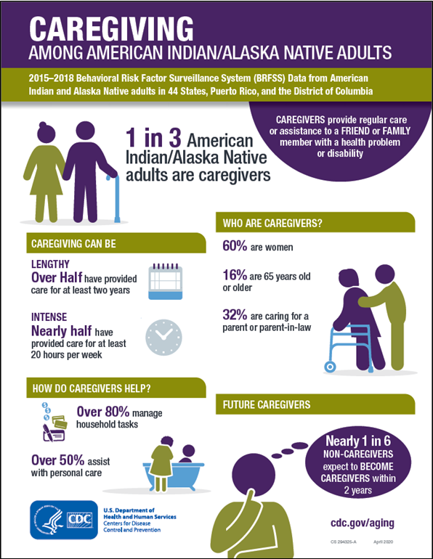

Slide 17
Compared to Other Caregivers Dementia Caregivers are:
Twice as likely to have physical or psychological problems
More than twice as likely to use medications for mood or nerves
As much higher risk of social isolation and economic distress
Only half as likely to use health care

Slide 18
What are you dealing with?
Check Those You Think Apply and Identify the Top 2-3 Problems
Personality Disorder
Continuation of Personality Traits
Depression
Effects of Disease
Call for Attention
Selfish Behavior
Normal Aging
Substance Problem
Behavior Problem
Other (specify)

Slide 19
Understanding Progressive Dementing Disorders like Alzheimer’s Disease
Dementia is not part of normal aging
Appreciate the scope and impact of these diseases and their prevalence in the elderly
Separate myths from facts

Slide 20
What is Dementia?
Dementia is a condition of global deterioration of memory and cognition that impairs thought and social functioning.

Slide 21
Required for Dementia Diagnosis
Serious Memory Problems
-- At Least One of the Following –
Difficulties with social functioning
Changes in personality
Impairment of abstract thinking
Disturbances of other thinking processes
Impaired judgement

Slide 22
Facts about Dementia
Not a part of normal aging
Produced by several diseases
Alzheimer’s disease is the most common cause
Vascular dementia is the next most common cause
Typically, not reversible

Slide 23
Depression
An extended state of sadness
Usually has other symptoms: apathy, loss of appetite, sleep problems, loss of interest in things
Very frequently seen in persons with dementia – and adds to the problems
Can be successfully treated
Sometimes even confused with dementia

Slide 24
Medications for Dementia
Some medications have shown some benefit
Appear to return the person to where s/he was 6-12 months before
Don’t stop or reverse the disease process
Research continues
Beware of Questionable Treatments (Ginko Biloba, Chellation)
Treat claims on the internet with suspicion

Slide 25
How many people do you think have dementia?

Slide 26
Facts about Dementia
4.5 million Americans Affected
Equal Opportunity Disease – Perhaps
Age Affects Onset
% affected

Slide 27
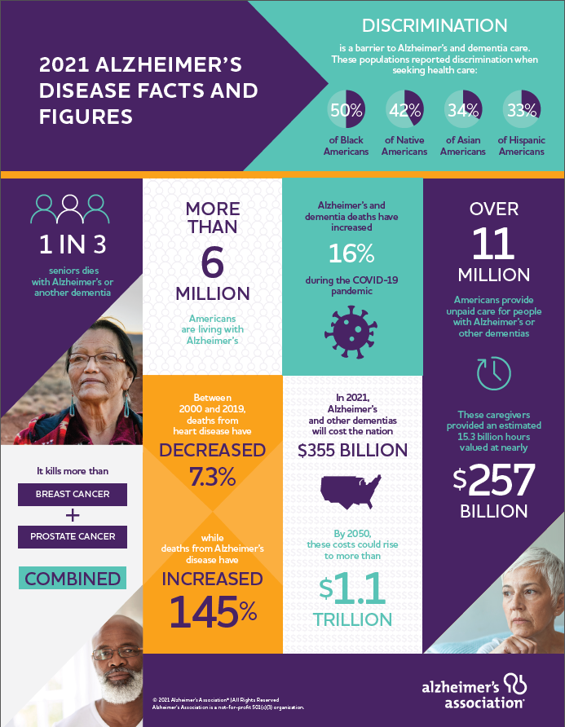

Slide 28
Myths and Fears
1
2
3
4
Contagious
Hereditary
Bizarre
Violent

Slide 29
The Course of Dementing Disease
O ~ 3 Years: Early Stages
3 ~ 10 Years:
Community-based Care
10 ~ + Years:
Late stage – Institutional Care
0
3
6
9
12

Slide 30
Important Elements of Thought
Thought or Cognition
Memory
Attention
Judgement & Perception
Reasoning
Organization
Abstraction
Language

Slide 31
Memory
Problems
Caregiving Issues
Early loss of recent memories
Long-term memories and over-learned behaviors remain longer
Gradual loss of detail in long-term
Eventually, virtually all memory fades
Social skills forgotten
Can’t depend on memory to prompt, orient, or stimulate
Don’t expect new learning
Things may feel more familiar, but every day will be new

Slide 32
Language
Problems
Caregiving Issues
Word finding difficulty starts early on
Structure of language breaks down
Eventually, language not at all useable
Frustration with word finding difficulty – supply missing words
Language increasingly unreliable for communication
Shorten and simplify sentences
Visual and tactile communication become more effective
Retained verbal skills may mask actual decline in thought
Allow pleasure in available verbal interactions

Slide 33
Reason
Problems
Caregiving Issues
Breakdown of connection between thoughts, objects, events, and actions
Behavior becomes more random and self-centered
Can’t reason with the person
Can’t bargain or negotiate
Person will, increasingly, not think in cause-and-effect terms

Slide 34
Judgment
Problems
Caregiving Issues
Increasingly make poor choices
Safety Issues
May lead to hesitancy or impulsivity
Insensitivity to others
Assume responsibility for safety – but don’t overprotect
Remember: “It’s not personal”

Slide 35
Perception
Problems
Caregiving Issues
Misperception – can’t interpret sensory input
Potential for overload
Suspiciousness and paranoia
Knowing how much is enough and too much
Distress related to delusions or hallucinations
Monitor environment, including media

Slide 36
Abstraction
Problems
Caregiving Issues
Loss of conventional concepts (time, distance, relationships)
Person increasingly concrete in thought
Inability to think in hypotheticals – “what ifs”
Providing directions – need to be more and more concrete
Can’t depend on abstraction to affect behavior (no ”if”… “then” thinking)

Slide 37
Attention
Problems
Caregiving Issues
Harder to stay on task
Easier to become distracted
Choice of suitable task
Attention to environment: remove distractions
Increasing need for monitoring and refocusing

Slide 38
Organization
Problems
Caregiving Issues
Less and less able to establish and remember that things are happening for a purpose
Less able to order actions
Less able to use plan to monitor actions
Size and complexity of tasks become problems
Right-sizing the task
Providing just the right amount of order – substitution
Providing appropriate direction (support and prompting)

Slide 39
Consider the Following Sentences
“We’re going to your brother’s for dinner on Thursday.”
Abstraction
“If we can have hamburger tonight, I won’t have to go to the store till the weekend.”
Reason, abstraction, and language
“I’ll leave your lunch in the Tupperware in the fridge; eat at noon.”
Memory and organization
“Take the medicine 3 times a day for the next 10 days.”
Memory, organization, judgement, attention

Slide 40
Make the Savvy Caregiver Shift
Wait till Thursday PM; then inform about dinner at brother’s house.
Concrete
“We’re having hamburger tonight.”
Directive – not reasoned
Leave written note about lunch (plus reminder call)
Reminders by you
Set up medication and remind – or administer them.
No expectation – take control

Slide 41
The Savvy Caregiver Workshop: Session 1 Objectives
1
2
3
4
Introduce selves and purposes of program
Gain appreciation for the caregiving role – an “unexpected Career”
Appreciate dementia and its impact on the person
Introduce workshop resources – text, slides, and handouts

Slide 42
Session 2 Objectives
Develop strategies for self-care
Develop caregiving strategies based on appreciation of disease impact

Slide 43
Four Quadrants of Feelings
Powerful
Negative
Positive
Powerless

Slide 44
Strategies for Changing Quadrants
Put the plan to work successfully
Do something: Use knowledge and skill to form a plan
Let go: Recognize the effects of the disease

Slide 45
Confusion
The World We Understand
Thought or Cognition
Memory
Attention
Judgement & Perception
Reasoning
Organization
Abstraction
Language
Confusion

Slide 46
Emotional Needs Related to Confusion
Calm
Safety
Security
Control
Reassurance

Slide 47
Confusion
Discomfort
Behavior

Slide 48
A Simple Model of Behavior
Person
Surroundings
Others
Behavior

Slide 49
Person
Person normally exert control over their actions
They choose, based on some calculation of benefit

Slide 50
Support from Others
Other people have an effect on behavior
They may prompt a behavior
They may encourage it to continue
They may reward it – or punish it

Slide 51
Surroundings
The place or setting where a behavior takes place can have a powerful effect
The way an activity is prepared, displayed, and monitored affects its success
Structuring Surroundings Helps to:
Channel behavior
Encourage or discourage it
Reduce options – or increase them

Slide 52
A Simple Model of Behavior
Person
Surroundings
Others
Behavior

Slide 53
Person
Surroundings
Others
Behavior
Progressive Decline of Thinking and Self-Control of Behavior in Dementia
Person
Surroundings
Others
Behavior
Person
Surroundings
Others
Behavior

Slide 54
Session 3 Objectives
1
2
3
Develop an appreciation for the benefits to the caregiver and care recipient of Contented Involvement
Appreciate how Fit contributes to Contended Involvement
Understand a Staging system for persons with Progressive Dementing Disorders

Slide 55
Content and Involved
Without distress
At ease
Pleasant
Within one’s limits and abilities
Not a stretch
Familiar
Sensible
Fits with you
Engaged
Zeroed in
Attentive
Focused Using one’s available skills
Busy
Concentrated

Slide 56
Things that take us from the Zone of Contented Involvement
Distractions
Overload
Boredom
Fatigue
Other physical needs (pain, hunger)
Depression

Slide 57
Catastrophic Reaction
Withdrawal
Distress
Distress
Contented Involvement
Under-Stimulation
Threats to Contended Involvement and Possible Consequences of Moving Out of the Zone of Contended Involvement

Slide 58
Cookie Making
Materials Needed
Actions Taken
Set oven
Measure things
Other preparation
Mix together
Stir
Shape cookies
Prepare cookie sheet
Put on cookie sheet
Bake
Cool
Recipe
Ingredients (flour, baking powder, eggs, butter, chocolate chips, sugar)
Utensils – bowls, spoons, measuring things, cookie sheet, mixer, cooling rack
Old-fashioned oven

Slide 59
Early Stage (Level 5.0: Signs Begin to Show)
-
Relatively able and Independent
-
Problems with planning, problem solving, and judgment (Executive Functions)
-
Problems with short-term memory
-
Should be able to manage most concrete tasks
-
Problems losing track in complicated tasks
-
May affect “quality” of performance – may behave impulsively or hesitantly

Slide 60
Early Middle Stage (Level 4.5: A Time of Increasing Problems)
-
Seems to perform normally, but errors creep in
-
Language still works to give information
-
Will keep a goal but may need reminders
-
Problems begin to show with thinking – handling abstract ideas is harder
-
More easily distracted; needs help staying on track; readily redirected
-
Easily frustrated; may be impulsive

Slide 61
Early-Middle (Level 4.0: Impairments More Noticeable)
Limited attention and easily distracted – reacts to pressure; abstract thought very weak
Simple and familiar tasks with few steps
Knows there’s a goal, but needs reminders
Clear trouble with memory, language, orientation, perception, and attention
Performance quality poor
Needs help organizing tasks
Needs short, concrete directions – visual cues

Slide 62
Late-Middle Stage (Level 3.5: Becoming Dependent in Basic Daily Tasks)
Confused – vague about purpose (may not feel any sense of purpose). Easily rushed or startled
Needs direction, may need help starting and with steps throughout the task
May be able to do 2-3 steps in order on own
Performance quality very poor. Still relates to objects. Easily frustrated
Needs visual and tactile information – language too abstract and must be simplified
Thinking severely impaired in all areas – may not remember caregivers

Slide 63
Late-Middle Stage (Level 3.0: Person Experiences General Confusion)
All thinking powers seriously affected
Very confused. Hard to understand what’s happening or what’s wanted of him/her
No purpose; order with help
Needs help starting and staying with all tasks
Very concrete – visual and tactile cues
Step-by-step help
Very easily distracted, frustrated, upset, confused. Don’t rush or pressure. Reassure

Slide 64
Late Stage (Level 2.0: Functioning with Minimal Abilities)
Powers of thinking virtually gone
Purpose and order are no more – must come entirely from outside
May or may not relate to objects
Needs total care
Goals of care are comfort
Involvement, at this stage, is almost entirely passive

Slide 65
Late Stage (Level 1.0: In Bed and Unresponsive)
Little or no consciousness or awareness
Sleeps much of the time
Total care
Comfort is the goal

Slide 66
Remaining Strengths
-
-
Needs direction throughout; follows appropriately and is independent in small parts
Completely Independent
-
Acts effectively, but with errors of performance or memory
-
Needs detailed, step-by-step directions
-
Needs help starting – may need prompting
-
Cooperates with care provided by others

Slide 67
Session 4 Objectives
Discuss Caregiver’s Estimates of Dementia Stages – these are “Starting Points”
Introduce Anchors of Contented Involvement
--Matching structure, support, and personal preferences to strengths of the person

Slide 68
Content and Involved in Tasks
Person: Personal likes and dislikes
Structure: Nature of task and how task is set up for the person
Support: How to instruct, guide, encourage, and keep on track

Slide 69
Important Dimensions of Tasks
Size
Complexity
Space/distance
Time
Skills

Slide 70
Stage (level) | Size | Complexity | Space/Distance
Early (5.0) | 4-6 steps | Can involve some abstracts | Can travel outside
Early-Middle (4.5) | 3-5 steps | Should be simpler | Might travel
Early-Middle (4.0) | 2-4 steps | More concrete | In one area reduce inputs
Late-Middle (3.5) | 1-2 Steps | Only concrete | At a table, no distractions
Late-Middle (3.0) | 1 step or passive | Concrete or passive | Table facing wall
Late (2.0) | Passive | Passive | Watching

Slide 71
The Order of Support Strategies as Dementia Progresses
Early
Late
Writing
Complex verbal directions
Verbal suggestions or reminders
Simple verbal directions
Words linked to demonstrations
Visual cue (pointing) or examples
Visual cue linked to naming
Handing step-by-step
Direct by touch

Slide 72
Abstract
Concrete

Slide 73
Based on Dr. Linda Teri’s ABC Model of Behavior (Antecedents – Behavior – Consequences)
The person decides something. The person does something or hears or feels something
The person does something, takes some action
Something happens as a result of the action that is taken
Something Happens
Action (behavior)
Result
Some results serve to produce a new action

Slide 74
Hall and Buckwalter’s Progressively Lowered Stress Threshold Model of Behavior in Dementia
Ability to handle multiple tasks and various kinds of stresses
High
Potential catastrophic reactions from overstimulation
Med.
Low
Comfort Zone
Potential for catastrophic reactions from under stimulation

Slide 75
Session 5: Objectives
1
2
3
Participants will appreciate that they developed/ strengthened their caregiving skills
They will experience an increased sense of mastery in their caregiving role
They will acquire additional skills – introduction to the options, outcomes, values, Likelihood Decision-Making Model

Slide 76
The Main Work of the Caregiver
Manage behavior: help person remain calm and in control
Manage own well-being: caregiver self-care
Manage resources – including family resources for care
Manage daily life: keep person enjoyably involved

Slide 77
The OOVL Decision-Making Grid
Figure 1
Values
Options
Likelihood

Slide 78
The OOVL Decision-Making Grid
Figure 2
Mrs. M.’s Well-being
Mr. M.’s Safety
Values
+++
-
++
Stay along with phone calls | Low | Med | Low
Daughter stays with Mr. M | High | Med | Med
Mrs. M quits her job | High | Med | Low
Options
Likelihood

Slide 79
Simplified OOVL Grid for Work-Related Decision
Figure 3
Outcomes
Mrs. M.’s Well-being
Mr. M.’s Hurt Pride
Values
+++
-
Daughter stays with Mr. M.
Med
Med
Options
Likelihood
Mrs. M. quits her job
Med
Low

Slide 80
Outcomes
Laundry gets done
Mr. L’s self-esteem
No Extra Work
Values
+++
+++
++
Mr. L Continues to help with laundry
High
Low
Med
Options
Mr. L no longer helps with laundry
Low
High
High
Likelihood
Mrs. L selects laundry tasks for him
High
Med
High

Slide 81
Session 6: Objectives
Participants will appreciate that they have developed/strengthened their caregiving skills (as with Session 5)
They will consider ways to strengthen their family resources for caregiving
They will review the content of the entire program and appreciate and acknowledge that they have acquired more knowledge and skills – and have altered their attitude about caregiving

Slide 82
Strategies for and Benefits of Family Participation in Caregiving
Effective use of the family as a resource
Improved Outcomes
Understanding what kind of caregiving family situation you are in
Quality of life of the person: good involvement; more caregivers
Knowing what kind of help you can ask for and expect
Caregiver quality of life: more free time
Family satisfaction:
feeling useful
Being able to provide specific directions for contended involvement (tasks, structure, support)
Family harmony: greater agreement

Slide 83
Five Types of Caregiving Families
Solitary Caregiving
Observed Caregiving
Tag Team Caregiving
Uneasy Caregiving Alliance
Collaborative Caregiving

Slide 84
Major Areas of the Savvy Caregiver Program
1
2
3
4
Improving your caregiver skills and knowledge – and outlook
Developing skills for self-care
Strengthening family resources
Strengthening decision-making skills

Slide 85
Skills for the Savvy Caregiver
Understanding the reality and meaning of losses in dementia; the impact of confusion
Clarifying an appropriate goal for caregiving – contended involvement
Mastering Savvy Caregiver Skills
Using the Stages (levels of performance)
Linking Stages to Structure and Support strategies
Seeing troubling behaviors as part of the confusion
Developing a caregiving routine
Improving communication

Slide 86
Contented Involvement
Support
Structure
Personal Preferences
The Anchors of Contented Involvement

Slide 87
Caregiver Self-Care
Recognizing and dealing with feelings – Using the quadrant model
Developing a repertoire of self-time activities

Slide 88
Family as a Caregiving Resource
Understanding family caregiving strategies and types
Overcoming barriers to stronger family caregiving
Schedules
Specific plans (tasks and activities with structure and support strategies)

Slide 89
The OOVL Decision- Making Model
Options
Outcomes
Values
Likelihoods
Impacts of Dementia on the Person and its impact on possible outcomes

Slide 90
Contact Us
301.933.6492
admin@iasquared.org
http://iasquared.org

